Slide 1
DISARM Milestone 4 Second Semester
Debris In Space Autonomous Removal Mechanism
1/20/2020
Notes:
Lets get it

Slide 2
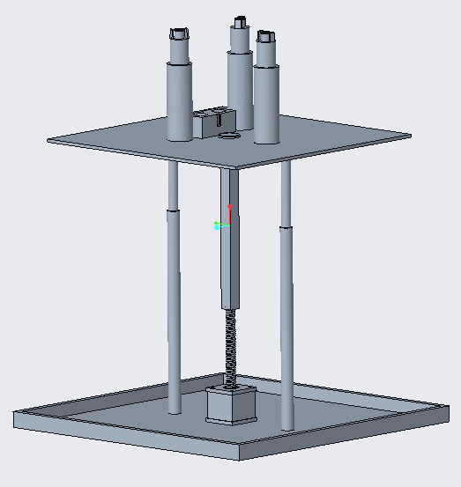
Content
MILESTONE TASKS
UPDATED SYSTEM DIAGRAM
SENSOR PLUGIN DEMO
FORWARD WORK

Slide 3
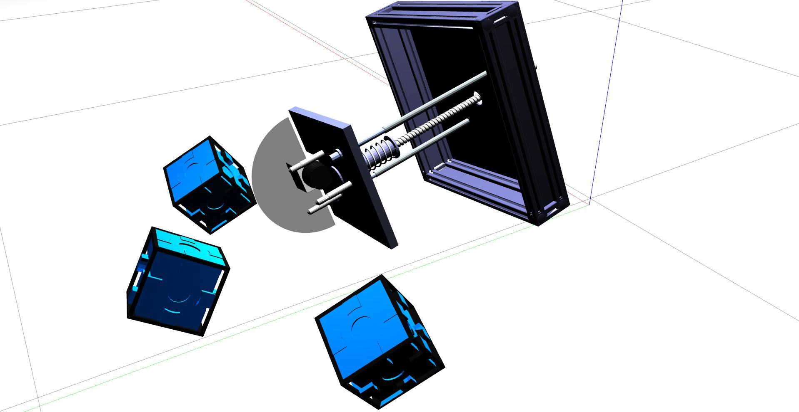
MILESTONE TASKS
Complete simulation requirements
Develop distance sensor from scratch (COMPLETED)
Implement algorithm for locating welding points. (PARTIALLY COMPLETED)

Slide 4
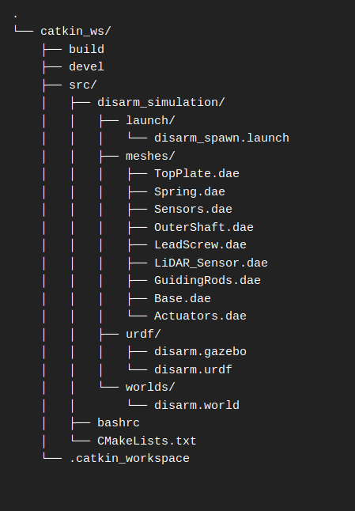
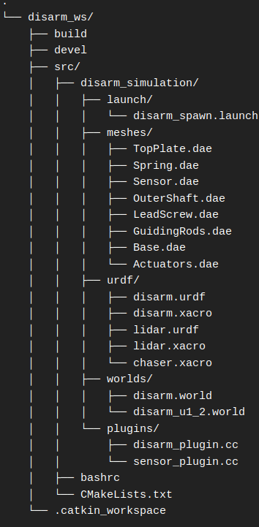
UPDATED SYSTEM DIAGRAM

Slide 5
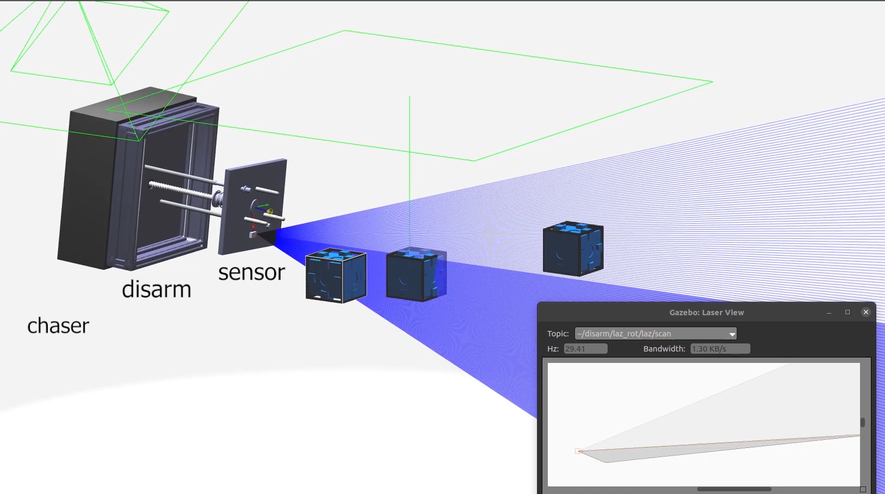
SENSOR PLUGIN DEMO

Slide 6
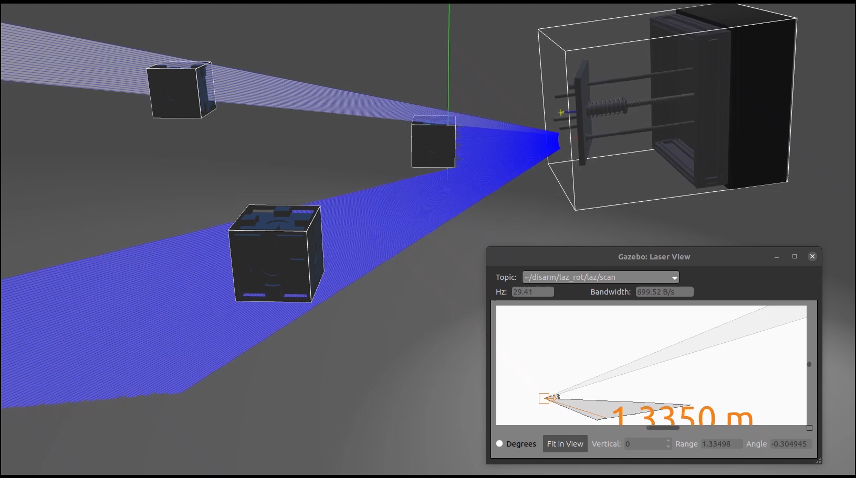
SENSOR PLUGIN DEMO

Slide 7
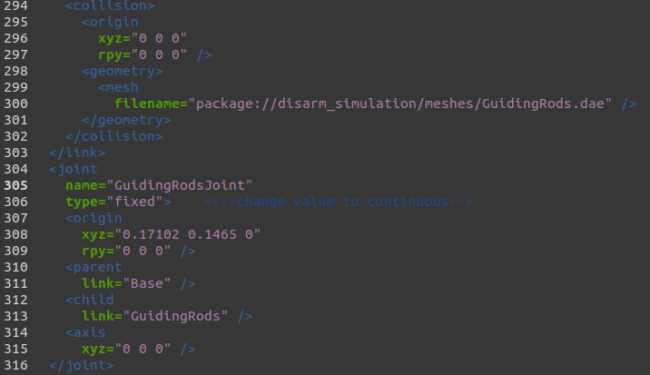
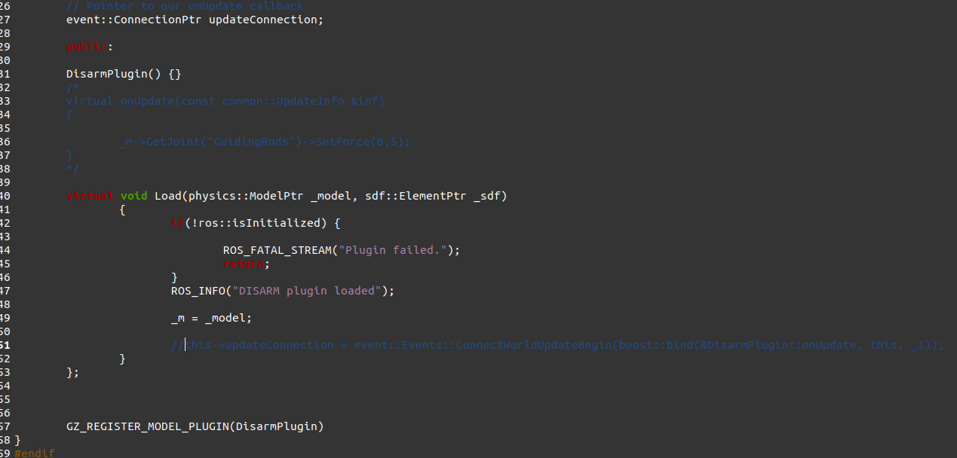
FORWARD WORK
disarm.xacro
disarm_plugin.cc

Slide 8
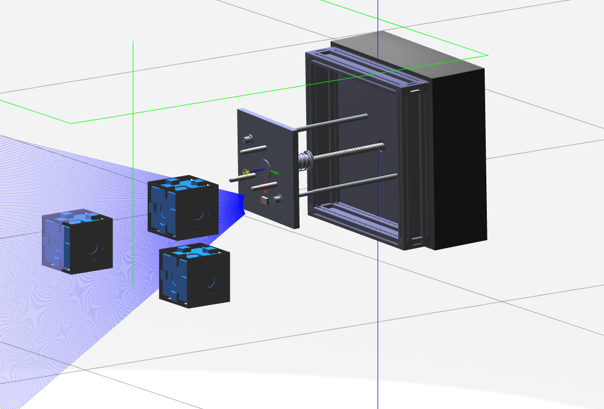
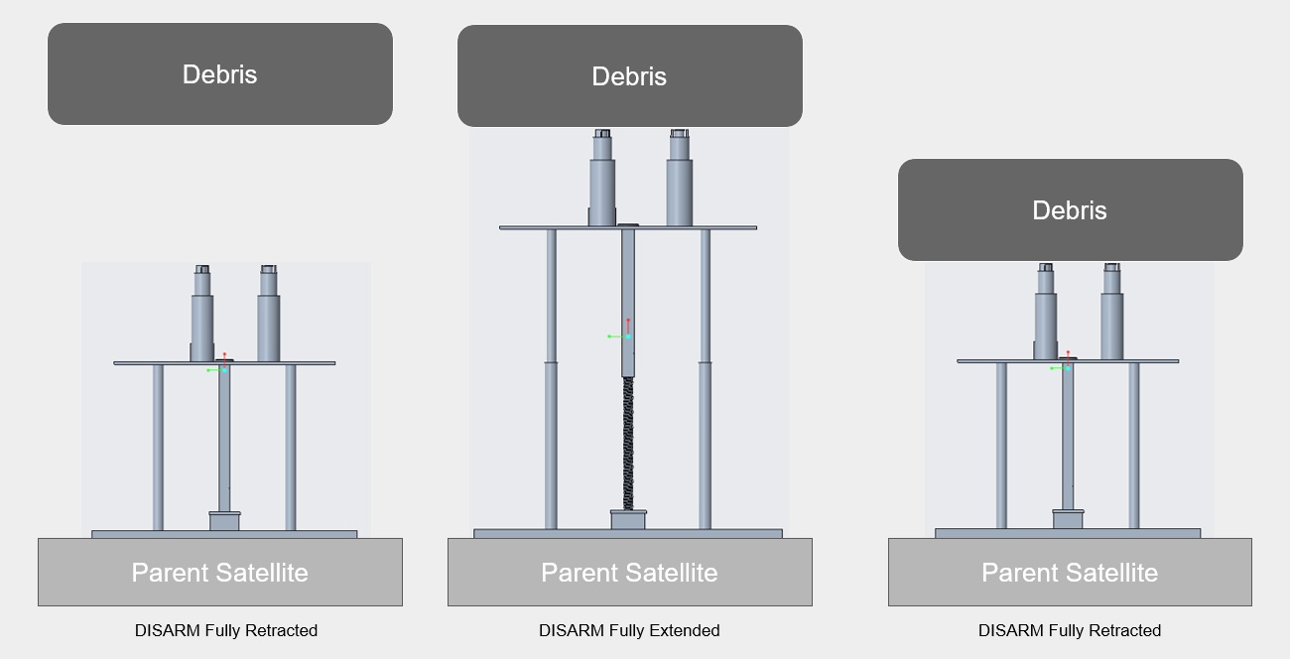
FORWARD WORK (MILESTONE 5)
Complete simulation requirements
Implement algorithm for locating welding points. (PARTIALLY COMPLETED)
Finish recording demo videos
Design poster and e-book

Slide 9


THANK YOU!
Any Questions?
Kyle Watkins, Project Manager
watkinsk2017@my.fit.edu
Luca Rizza, Systems Engineer
lrizza2017@my.fit.edu
Laura Guziczek, Engineer
lguziczek2018@my.fit.edu
Michael Leard, Engineer
mleard2017@my.fit.edu
Ali Lebbar, Engineer
alebbar2016@my.fit.edu
Davey Renoid, Engineer
drenoid2016@my.fit.edu
Matthew Intriago, Computer Science
mintriago2017@my.fit.edu
Vincent Panichelli, Engineer
vpanichelli2017@my.fit.edu
Daniel Soto, Engineer
dsotoperezco2017@my.fit.edu
Nouraldean El-Chariti, Engineer
nelchariti2017@my.fit.edu

